Slide 1

Stayze Rent Prediction Hackathon
DATASOL TEAM
MRINMOYEE MONDAL
SRILASYA GARIGIPATY

Slide 2
PROBLEM STATEMENT
Background:
Stayze is an online market for providing lodging or primary homestays. The company does not own any real estate or properties, it acts as a broker receiving commission from each booking.
The hosts rent out their property, its availability, area, type of room, price etc. and the travellers can book accordingly. The travellers put in their reviews, which is visible to others.
People have used this service extensively and the company is recognized throughout the globe. All the online activities of the hosts as well as the travellers are being captured and have resulted in a rich database.
Problem Statement:
The stakeholders with the help of the available data want to know the ideal prices at which the properties can be rented, as it will help them decide upon the ideal investment to be done.
In this hackathon, a machine learning model to predict the ideal price of the rental is created.

Slide 3
POTENTIAL BUSINESS PROBLEMS
How will Stayze market the hosts properties listed on their website, and generate more revenue?
What parameters should Stayze focus on to increase property rentals?
How can the ideal price of property rentals be determined and what features should company examine to determine the rents?
How can hosts list their properties on Stayze so that both Stayze and the hosts are earning optimal revenue from the rentals?
Stakeholders: Chief Marketing Officer of Stayze, Shareholders who have invested in company, and also the hosts who have listed their rental properties with Stayze, guests of properties

Slide 4
Why Solve This Problem?
Business Impact
Improve prediction -> identify common factors of optimize rental price
Improve prediction -> identify right target property owner-> efficient budget for investment
Improve prediction-> identify right location to invest

Slide 5
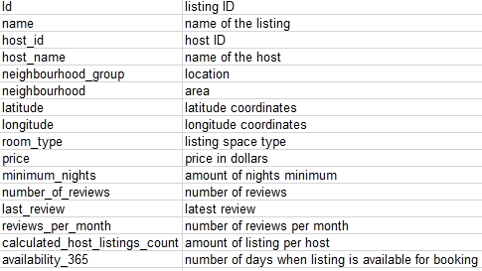
Dataset Information
The data contains 34227 clients and 16 features. There are 16 features and one target variable(price which describes
The cost for renting. The features and their description are shown below:

Slide 6
Evaluation Metrics:
The evaluation metric for this project is low root mean-squared error (RMSE) based on cross validation.
Other metrics also used in evaluation include high R2, and low mean-squared error.

Slide 7
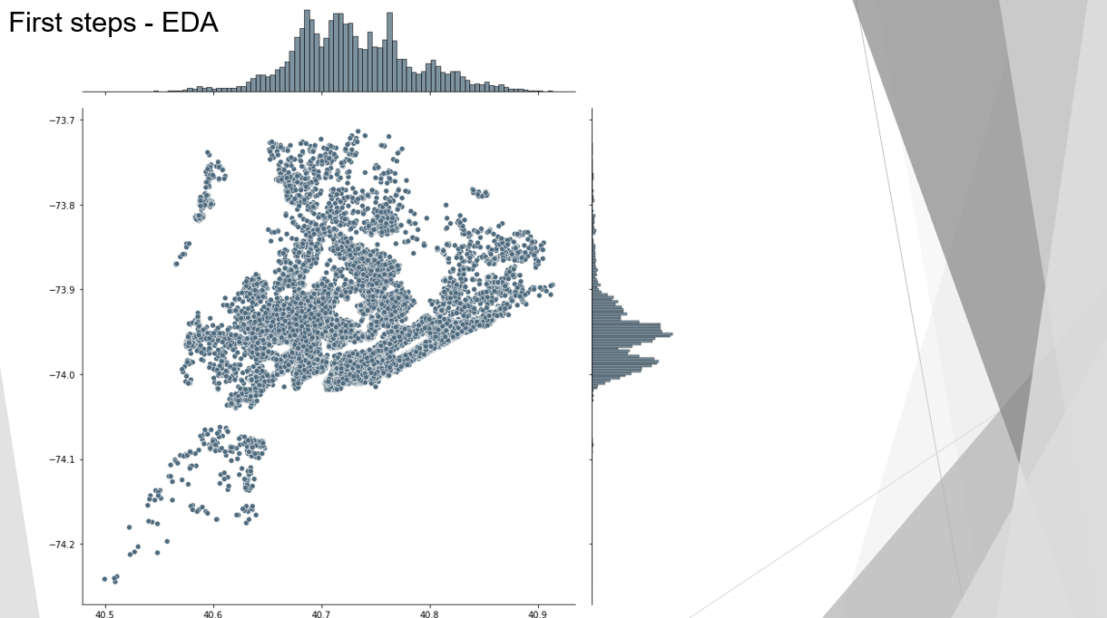

Slide 8
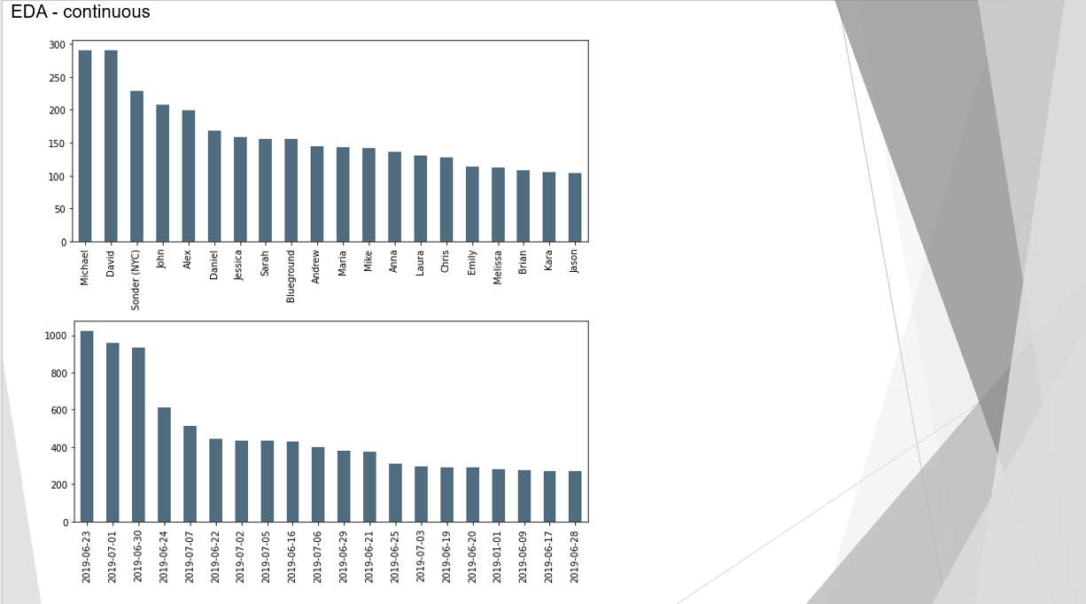

Slide 9
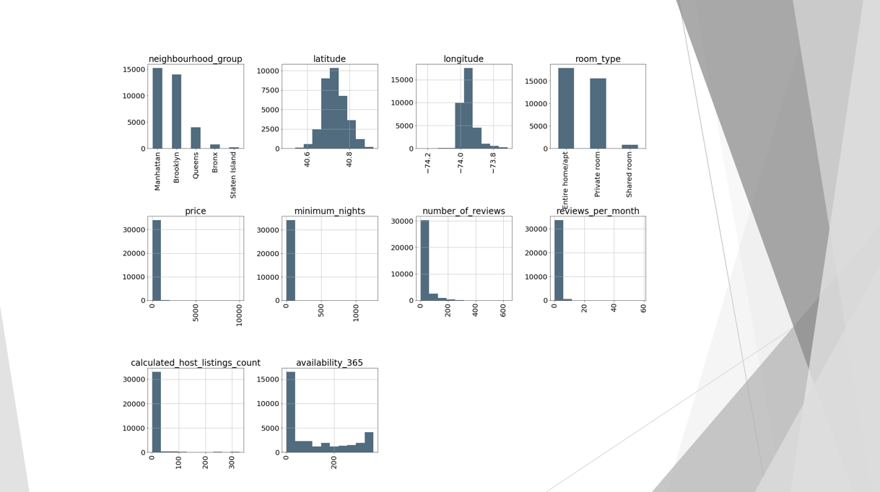

Slide 10
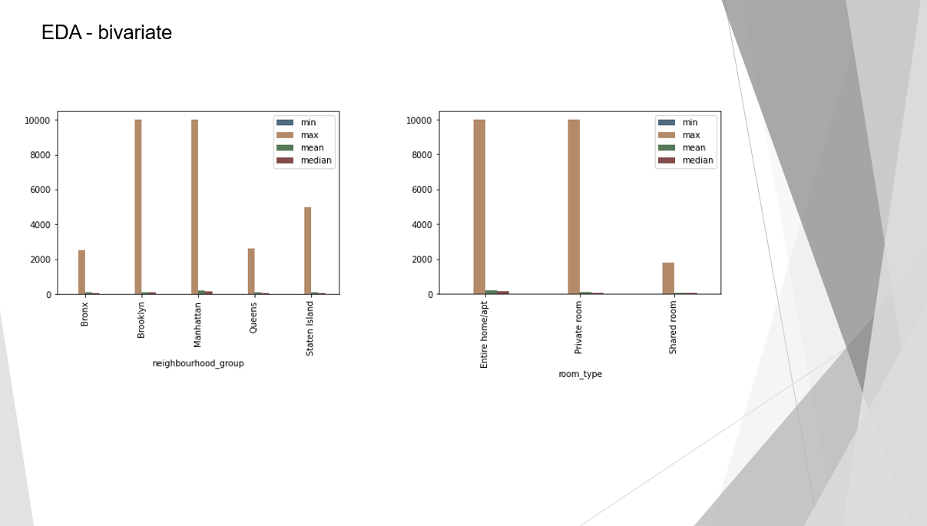

Slide 11
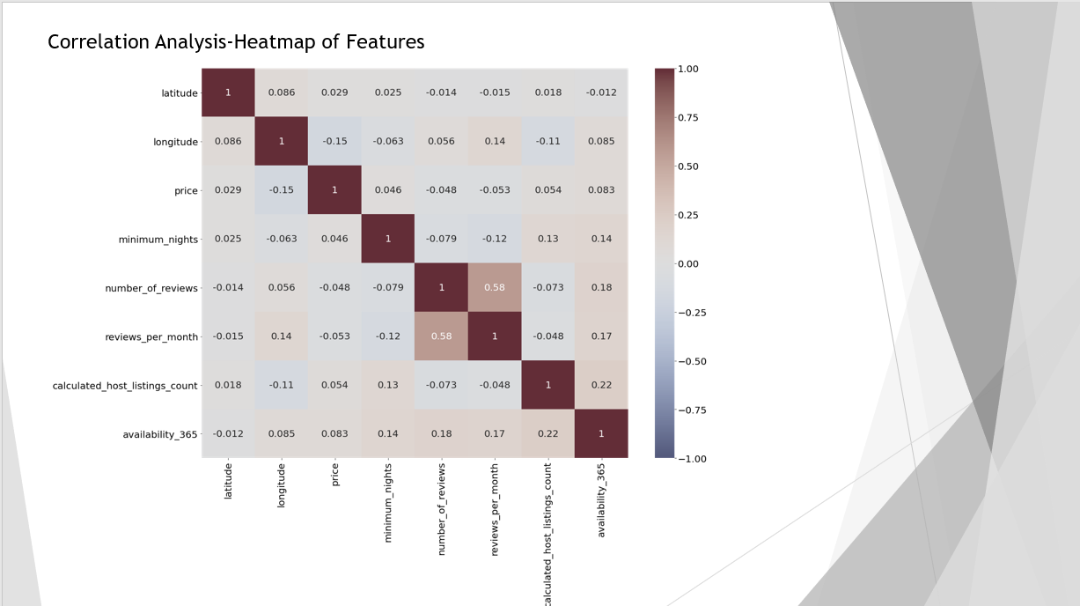

Slide 12
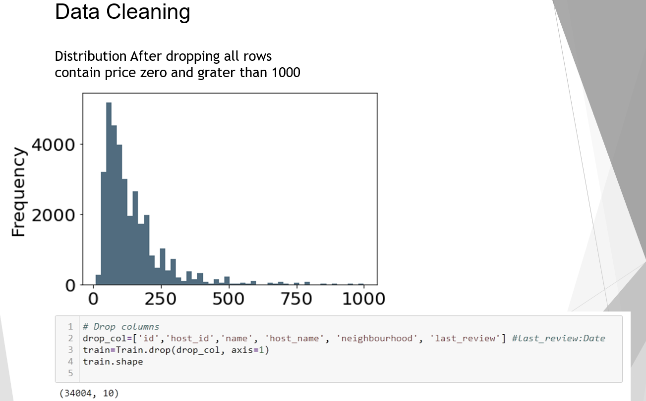
Pipeline
Feature Selection :
Following methods were used for feature selection :
- Correlation
-Outlier Analysis on “Price’ variable to reduce skewness
After doing the above analysis between continuous features, following features were chosen
Dropped:
'id',’
name’,
'host_name’
'neighbourhood’,
'last_review'

Slide 13
Pipeline

Slide 14
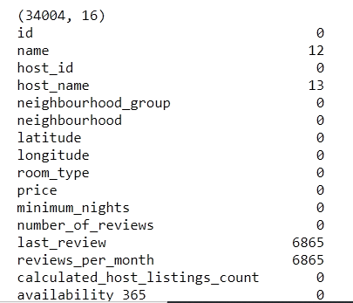
Pipeline
Missing Value Imputation:
Missing Values in these features were replaced with 0.

Slide 15
Models and Approaches
Linear Regression
Lasso Regression
Ridge Regression
Adding Polynomial Features to Linear Regression Model
Random Forest Regressor
Stochastic Gradient Boosting Regressor
Decision Tree Regressor
Hyper-parameter tuning was done using Grid Search on Lasso and Ridge Regression, and cross validation was done on all models.

Slide 16
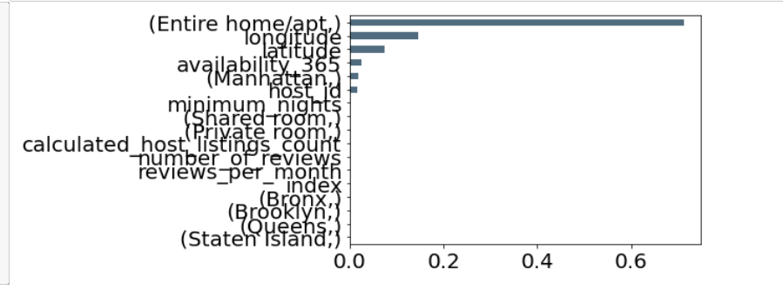
Pipeline
Feature Importance graphed from Random Forest Regressor:

Slide 17
Models and Approaches
Model | RMSE | MSE | R2 | CV R2
Linear Regression | 2.98 | 8.89 | 0.44 | 0.45
Lasso Regression | 3.83 | 14.66 | 0.09 | 0.09
Ridge Regression | 2.98 | 8.89 | 0.44 | 0.45
Polynomial Features to Linear | 3.12 | 9.79 | 0.38 | 0.37
Random Forest | 2.94 | 8.67 | 0.46 | 0.47
Decision Tree | 3.09 | 9.55 | 0.41 | 0.41
Stochastic Gradient Boosting Regressor | 2.86 | 8.15 | 0.49 | 0.50
Grid Search Lasso | 2.98 | - | 0.45 | -
Grid Search Ridge | 3.828 | - | 0.45 | -

Slide 18
Final Results
From the above observations and plottings it can be inferred that the best performing model was Stochastic Gradient Boosting Regressor with lowest RMSE and MSE of 2.86 and 8.15.It also had the highest R2 value of 0.50 with cross-validation.
Insights and Decisions
From previous pricing trends, if a room is priced over the predicted prices there may be a possibility of customers not booking the rooms which directly causes a revenue loss to the company and the hosts.
Rental prices should be accordingly to the pricing trends.
Marketing Team should target hosts for pricing according to importance of top features which were room type, location, and availability.

Slide 19
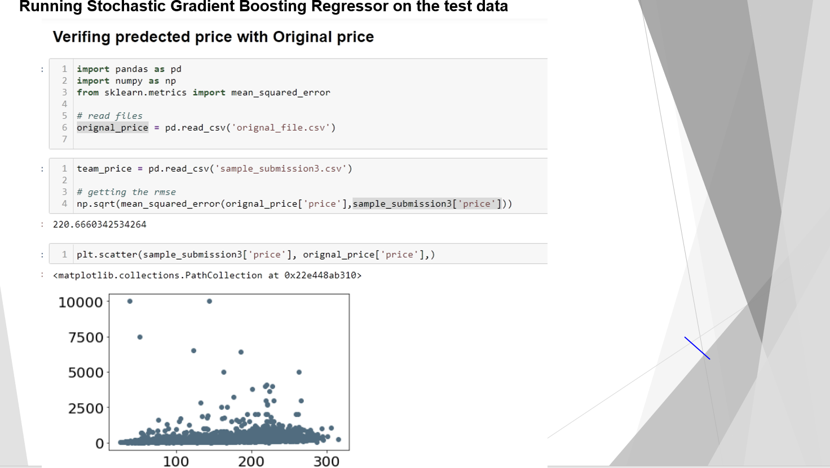

Slide 20
Future recommendations to improve model accuracy
Need more proper cleaning specially outlier and missing value treatment
Feature Engineering and using important feature into the model
Try different algorithm
Grouping Prices to create different models to have a better analysis, as prices are over a very wide range.
Income Data, Area Stats

